Slide 1
Set Cover approximation algorithm

Slide 2
Given a universe U of n elements, a collection of subsets of U say S = {S₁, S₂…,S_{m}} where every subset S_{i} has an associated cost. Find a minimum cost subcollection of S that covers all elements of U.

Slide 3
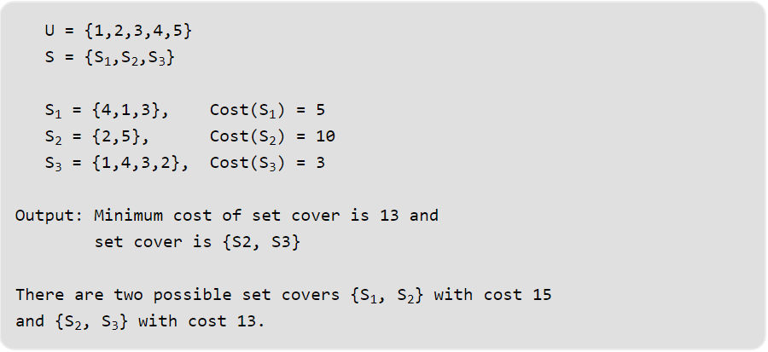

Slide 4
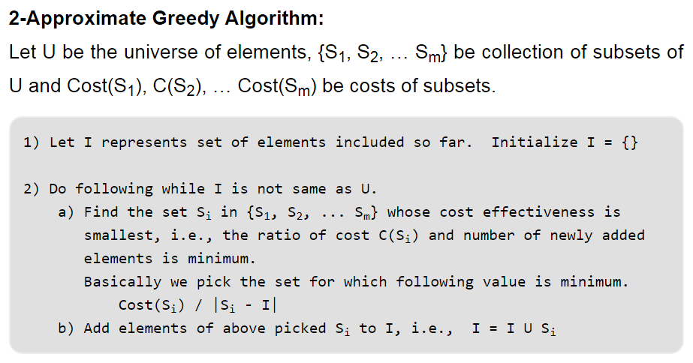

Slide 5
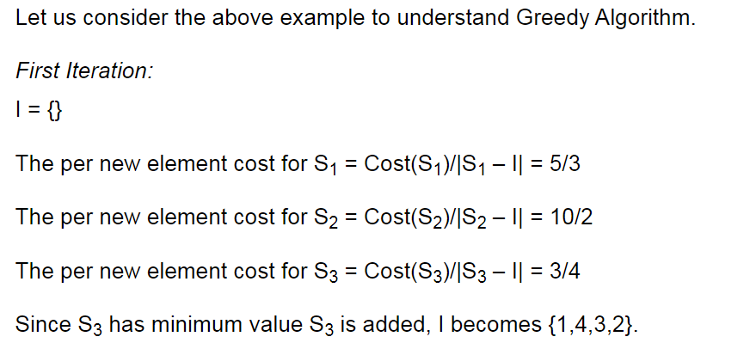

Slide 6
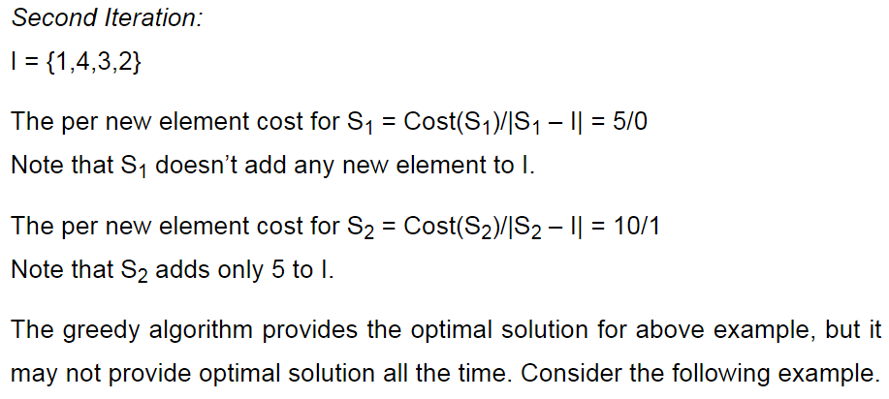

Slide 7
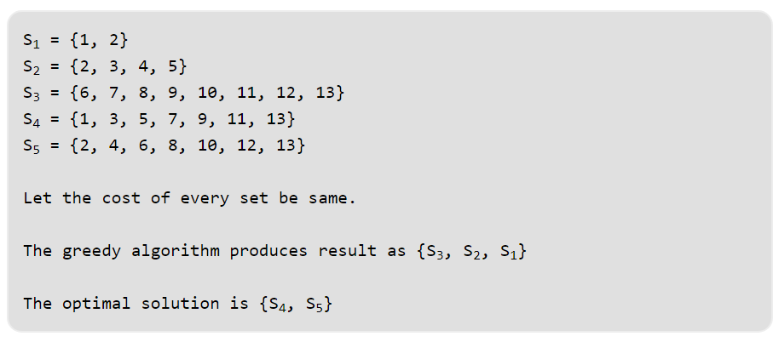

Slide 8
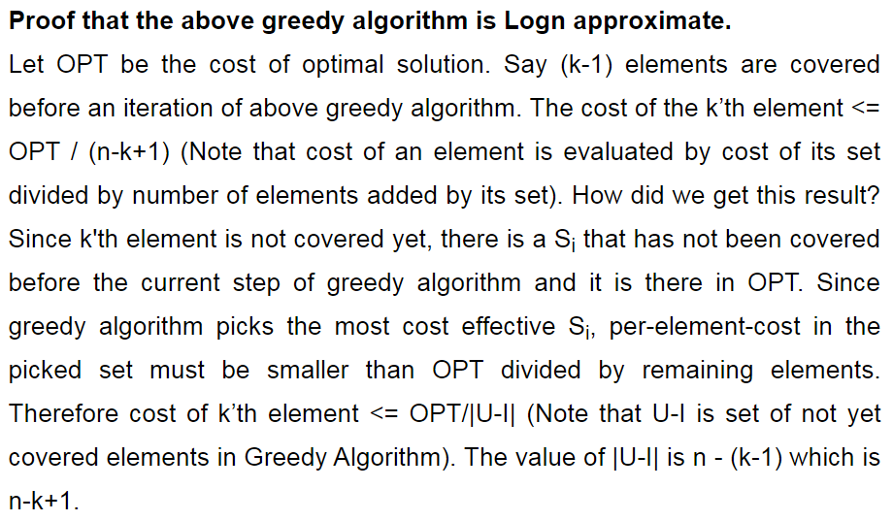

Slide 9
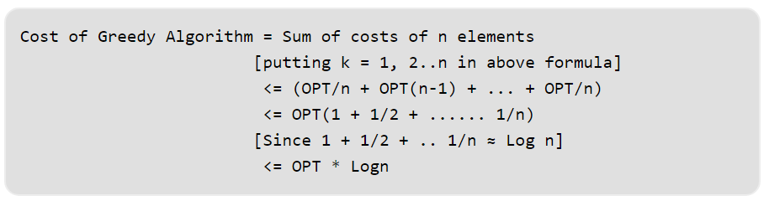

Slide 10
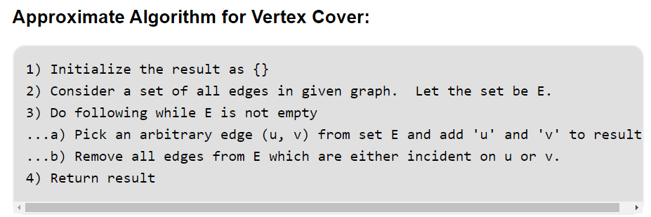
Vertex Cover

Slide 11
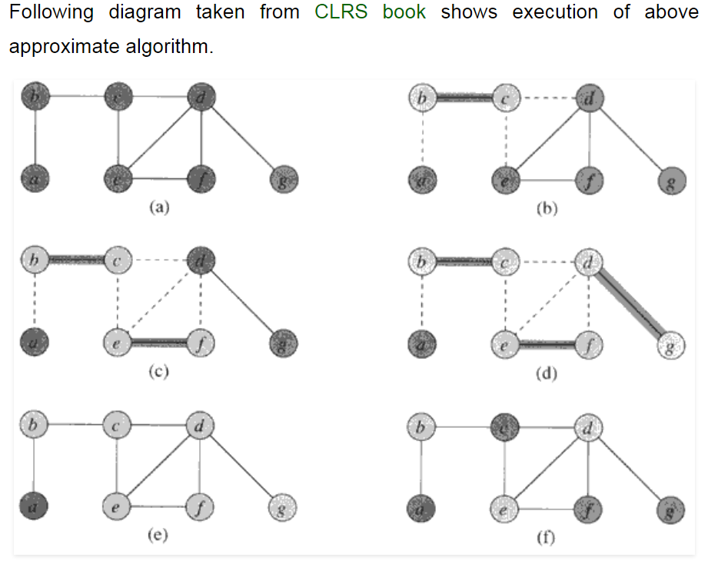

Slide 12
Goal: Since this a minimization problem, we are interested in smallest possible c/c*. Specifically we want to show c/c* ≤ 2 = p(n). In other words, we want to show that APPROX-VERTEX-COVER algorithm returns a vertex-cover that is atmost twice the size of an optimal cover.
Proof: Let the set c and c* be the sets output by APPROX-VERTEX-COVER and OPTIMAL-VERTEX-COVER respectively. Also, let A be the set of edges selected by line 4.
Because, we have added both vertices, we get c = 2|A| but OPTIMAL-VERTEX-COVER would have add one of two.
=> c/c* ≤ p(n) = 2.
Formally, since no two edge in A are covered by the same vertex from c* (since, once an edge is picked in line 4, all other edges that are incident on its endpoints are deleted from E` in line 6) and we the lower bound:
|c*| ≥ A ---------------------------------- 1
On the size of an OPTIMAL-VERTEX-COVER.
In line 4, we picked both en points yielding an upper bound on the size of Vertex-Cover.
|c| ≤ 2|A|
Since, upper bound is an exact in this case, we have
|c| = 2|A| ---------------------------------- 2
Take |c|/2 = |A| and put it in equation 1
|c*| ≥ |c|/2
|c*|/|c| ≥ 1/2
|c*|/|c| ≤ 2 = p(n)
proving the theorem. □

Slide 13
Sum of Subset

